Slide 1

Heart Rate Monitoring using Machine Learning
Capstone Project Phase B – 61999
24-1-R-8
By:
Ali Mohsen
Mohammad Khamaisy
Supervisor
Zeev Frenkel

Slide 2
Introduction
Heart rate is essential for evaluating cardiovascular health and fitness.
Many people are interested in tracking their heart rate.
Numerous heart rate monitoring apps are available.
Most apps lack personalized abnormality detection.
This often leads to false positive or false negative results.

Slide 3
Why?
Automatic heart rate monitoring
Detection of abnormalities based on specific user activities
Intelligent alert system
Capability for the system to improve by learning from the collective user data

Slide 4
Our Solution
A heart rate monitoring app that integrates device-based measurement with machine learning.
It delivers real-time tracking of heart rate and identifies abnormalities.
Offers customized insights for each user.

Slide 5
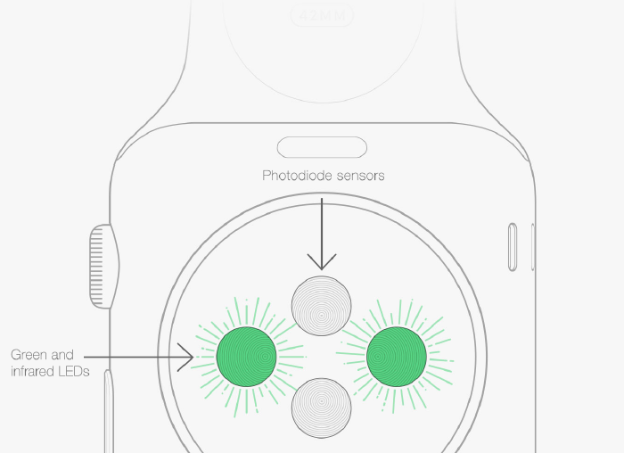
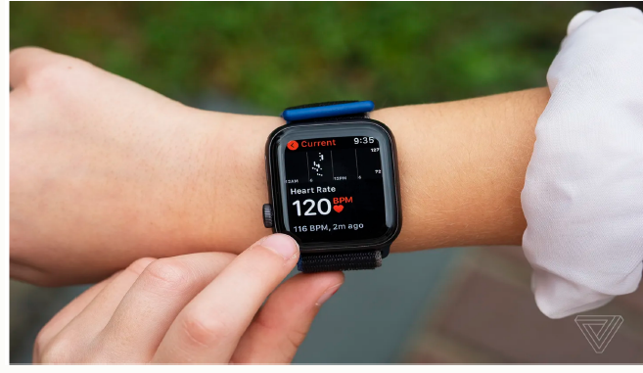
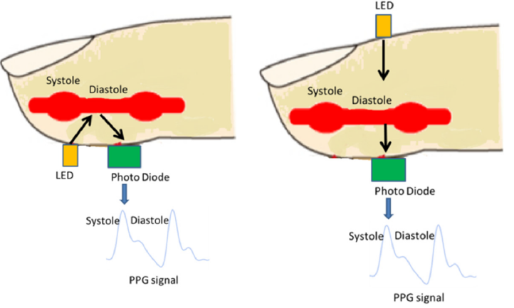
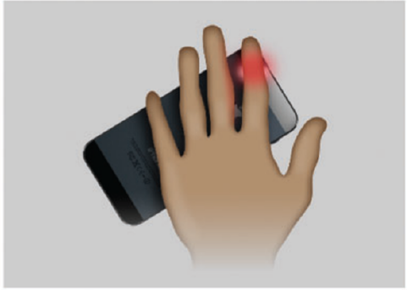
Sensors we use to collect the data
Our app uses PPG sensors, accelerometers, and ECG sensors

Slide 6
Data Base
We used MongoDB to store and manage user profiles and heart rate data efficiently.
Builds personalized models for better anomaly detection and insights.

Slide 7
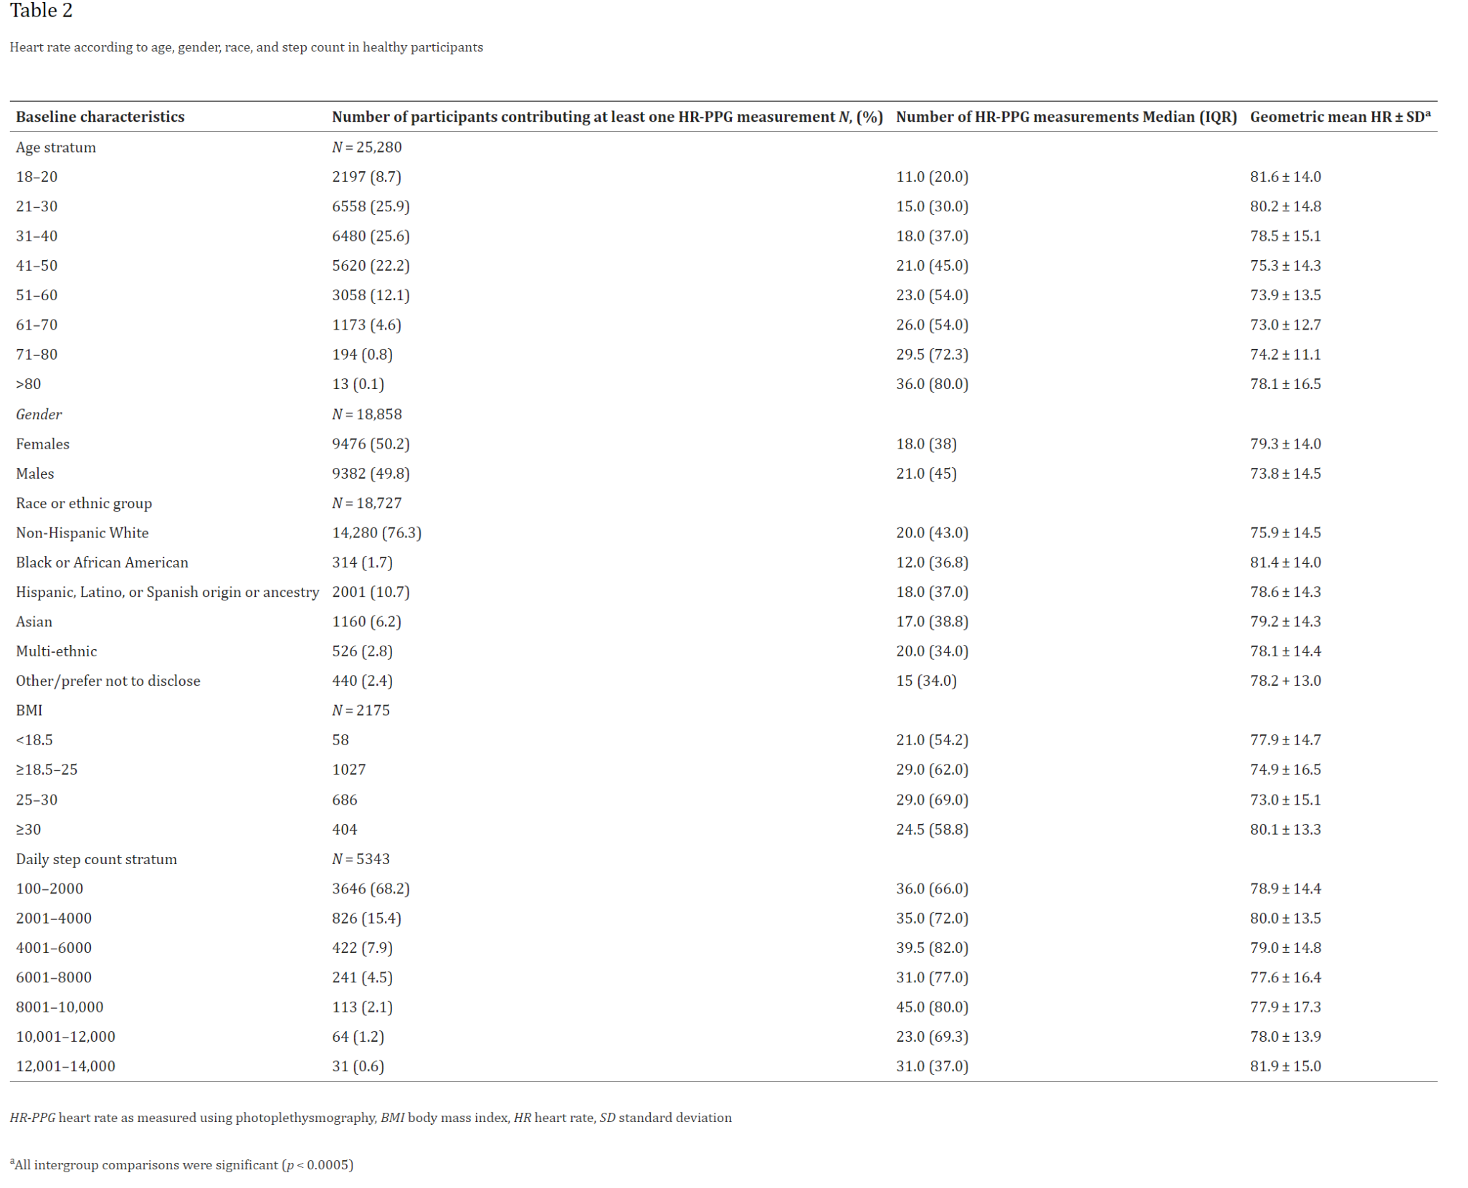
Real-world heart rate norms in the Health eHeart study that has been done in University of California, San Francisco (UCSF), in collaboration with Azumio, Inc.

Slide 8
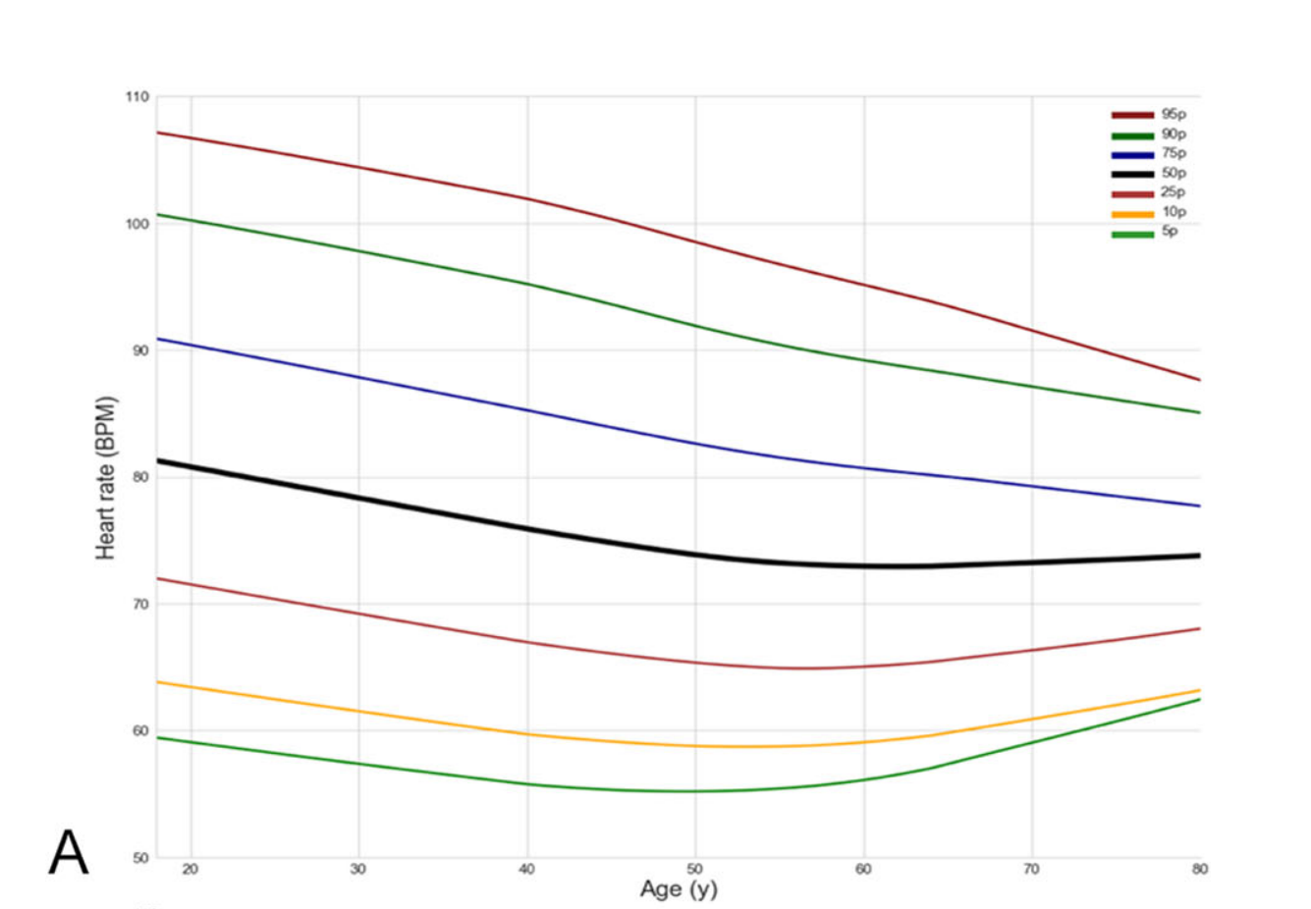

Slide 9
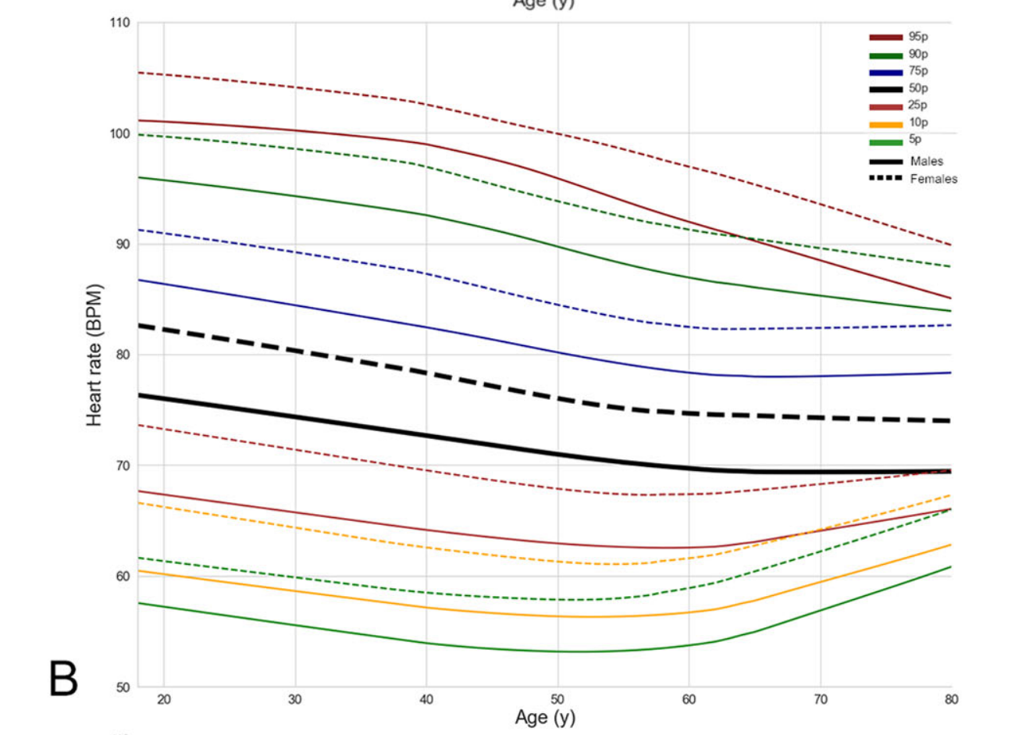

Slide 10
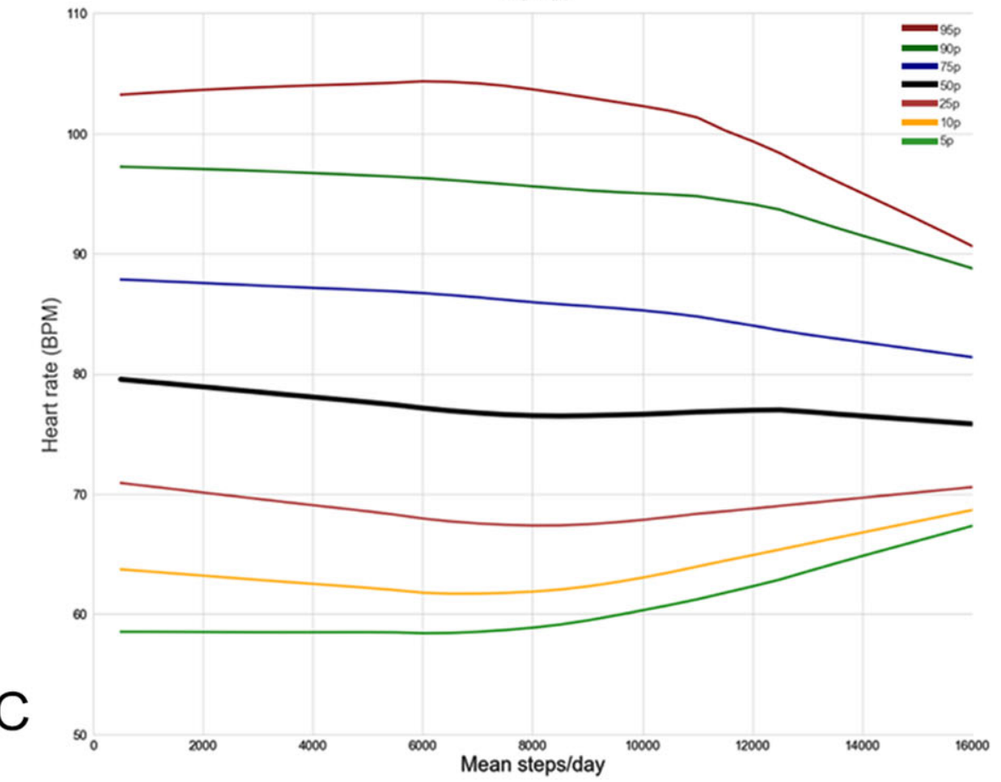

Slide 11
How It works and GUI

Slide 12
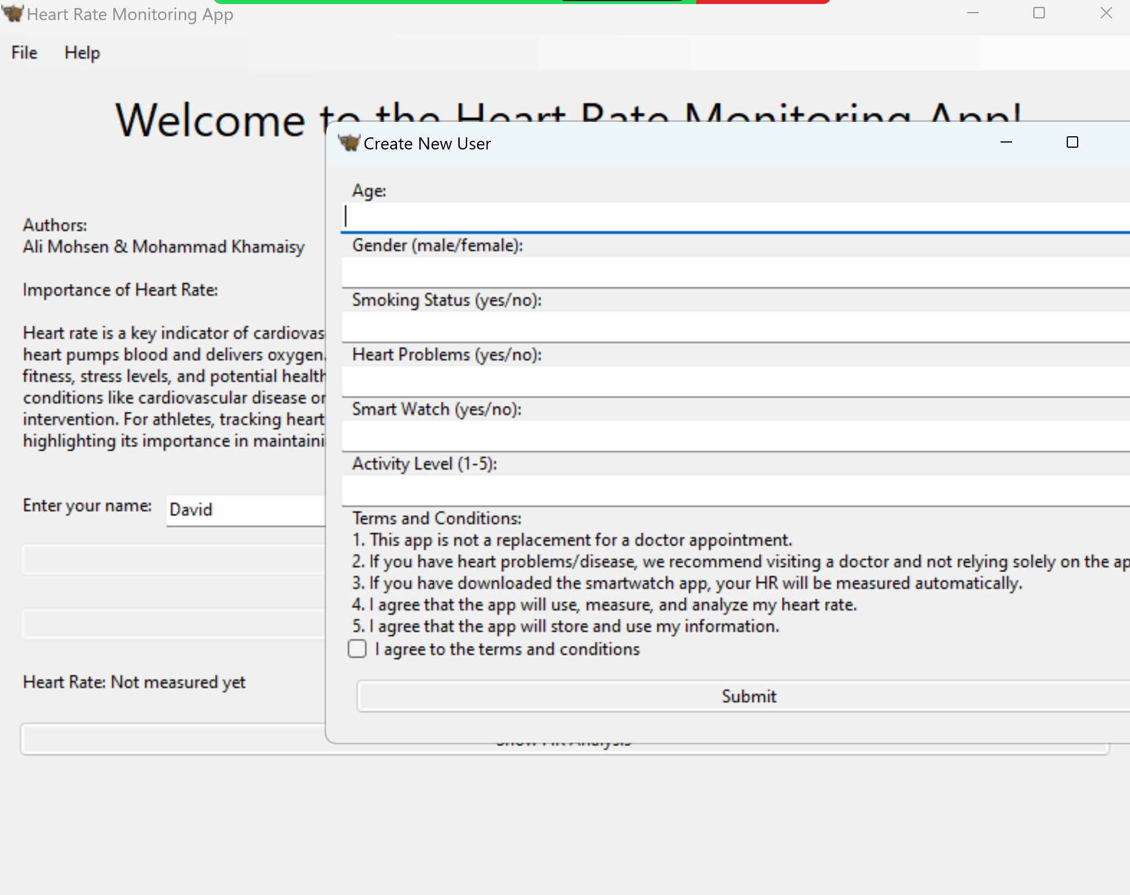
Start with personal questions and a terms agreement for a new user

Slide 13
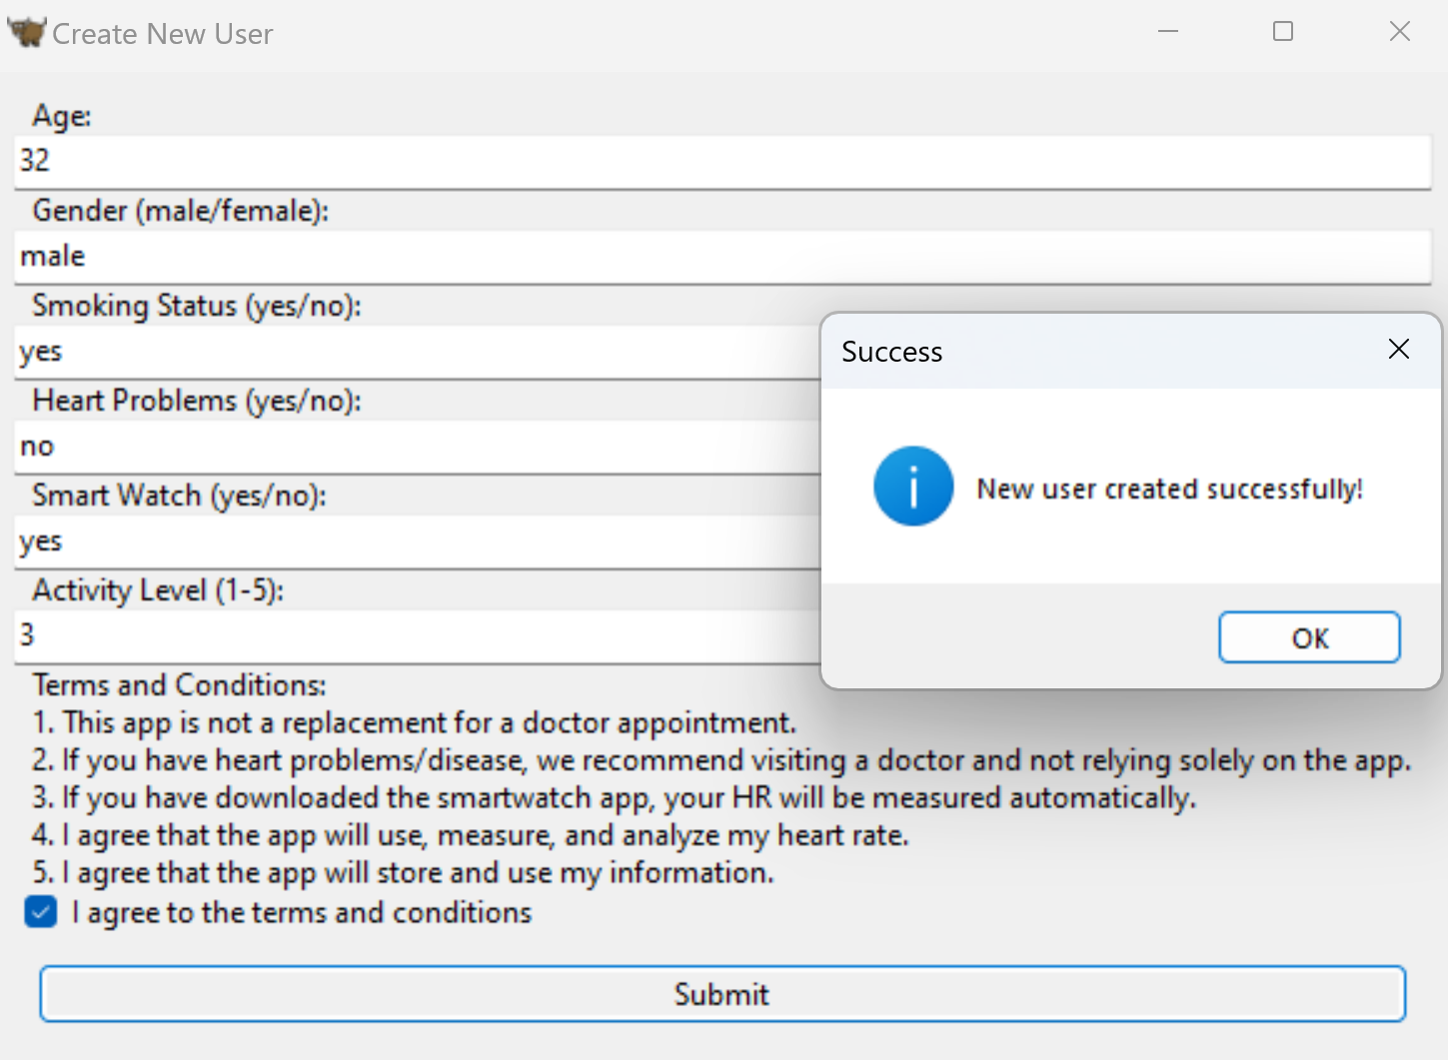
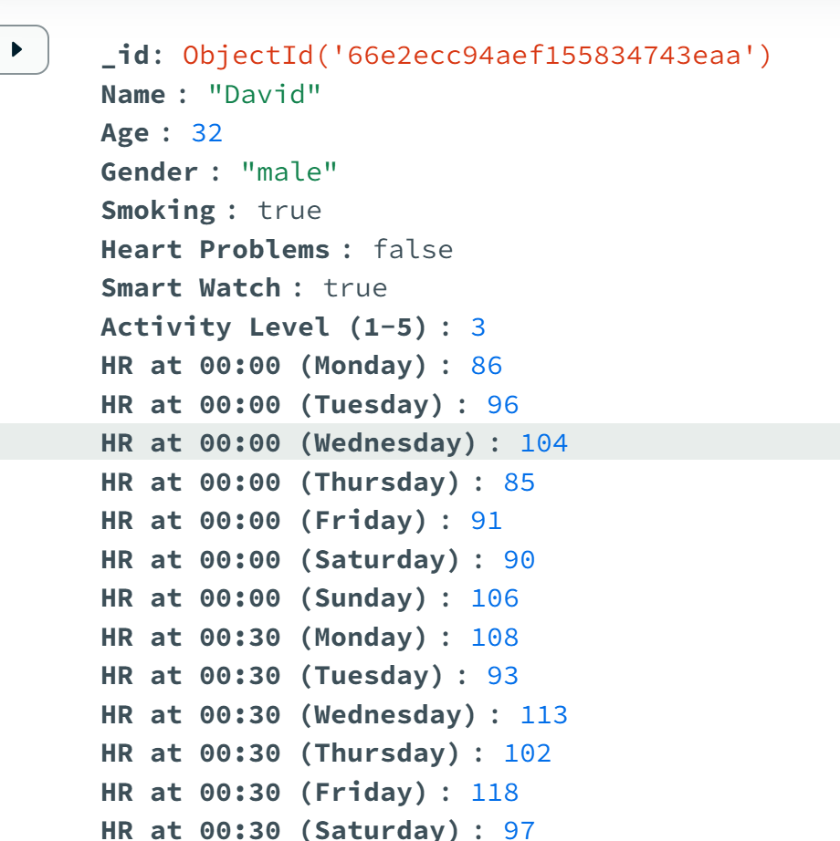
Created a new user

Slide 14
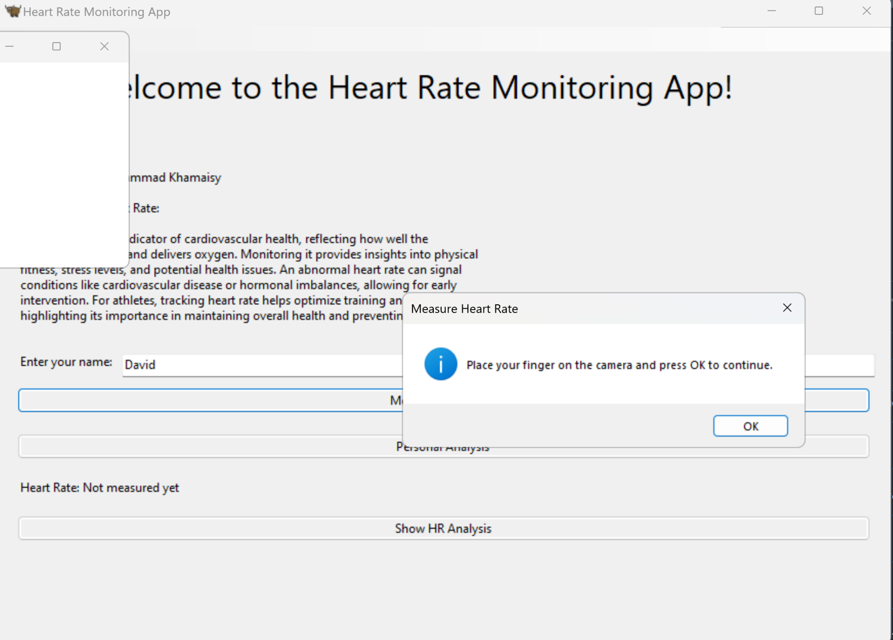

Automated or via button for heart rate monitoring phone camera.
Camera while measuring

Slide 15
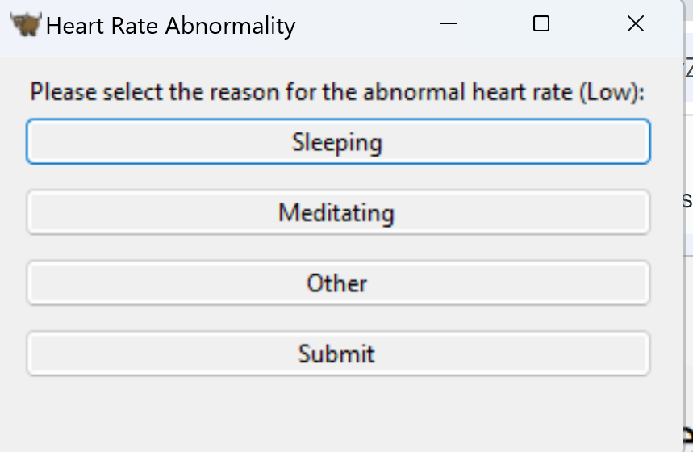
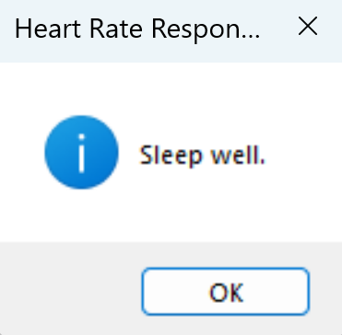
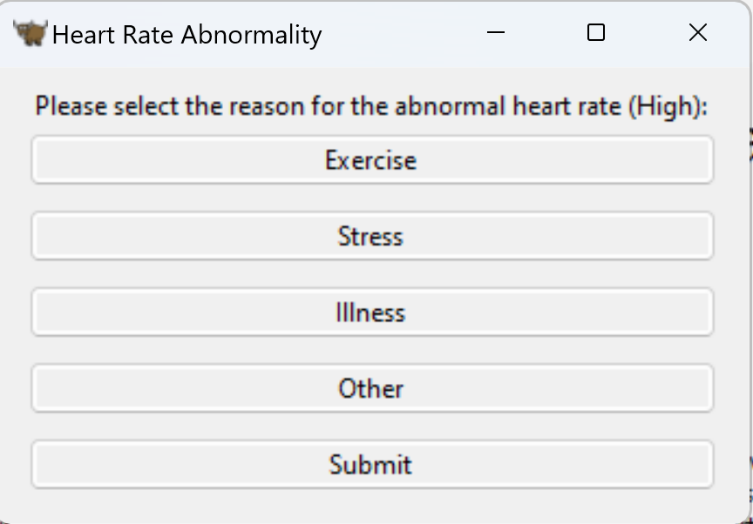
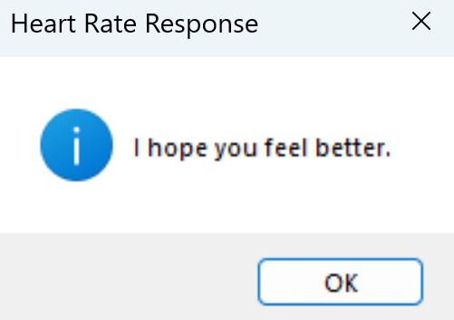
Ask what the reason
Send a message accordingly

Slide 16
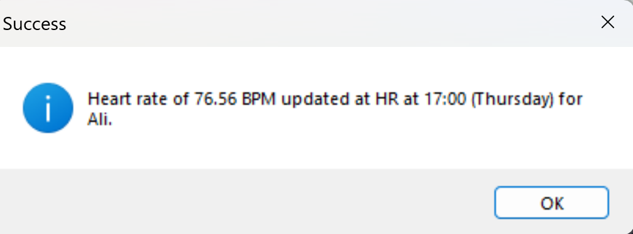
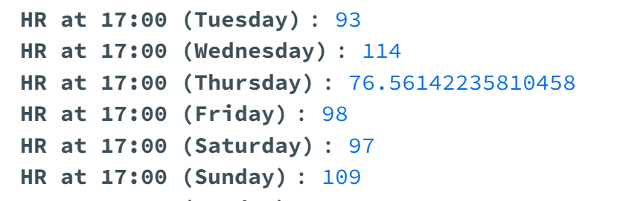

Slide 17
Real time data processing and learning the system - Machine learning algorithms

Slide 18
ARIMA and SMA
ARIMA (AutoRegressive Integrated Moving Average):
AR: Uses past observations for forecasting.
I: Differencing to achieve stationarity.
MA: Models residual errors from past forecasts.
Purpose: Predicts future values based on historical data.
Simple Moving Average (SMA):
Averages: A set number of past data points.
Purpose: Smooths data and identifies trends.

Slide 19
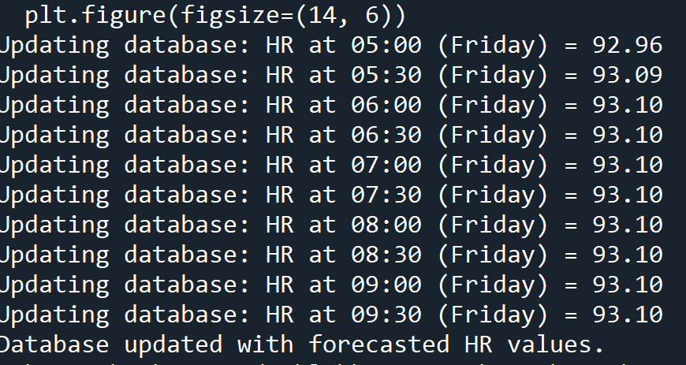
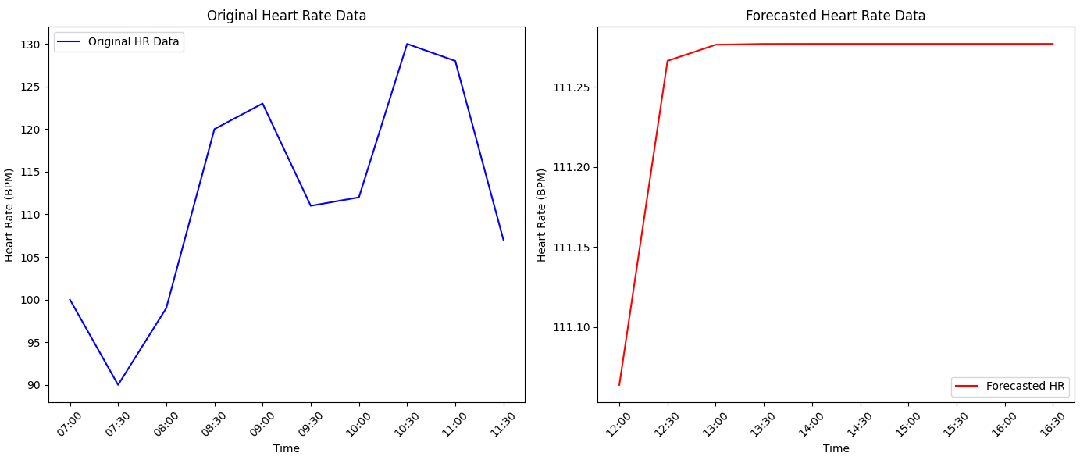
Updating values in the DB automatically according to ARIMA model and showing plots

Slide 20
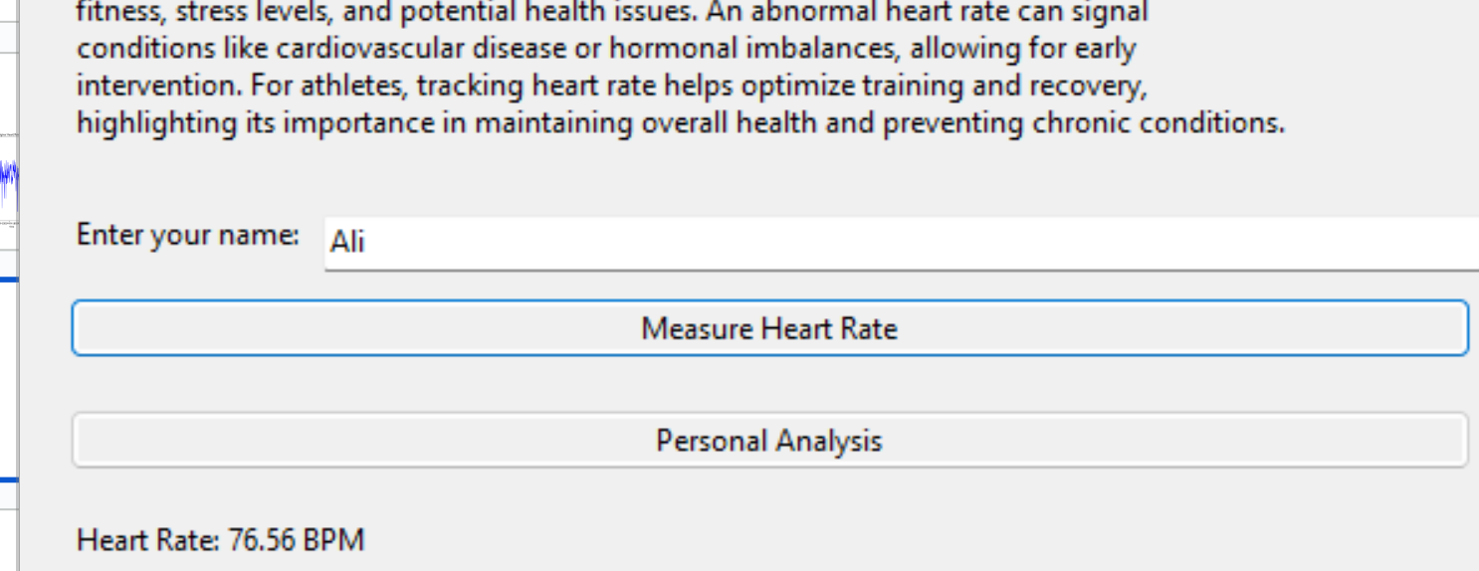
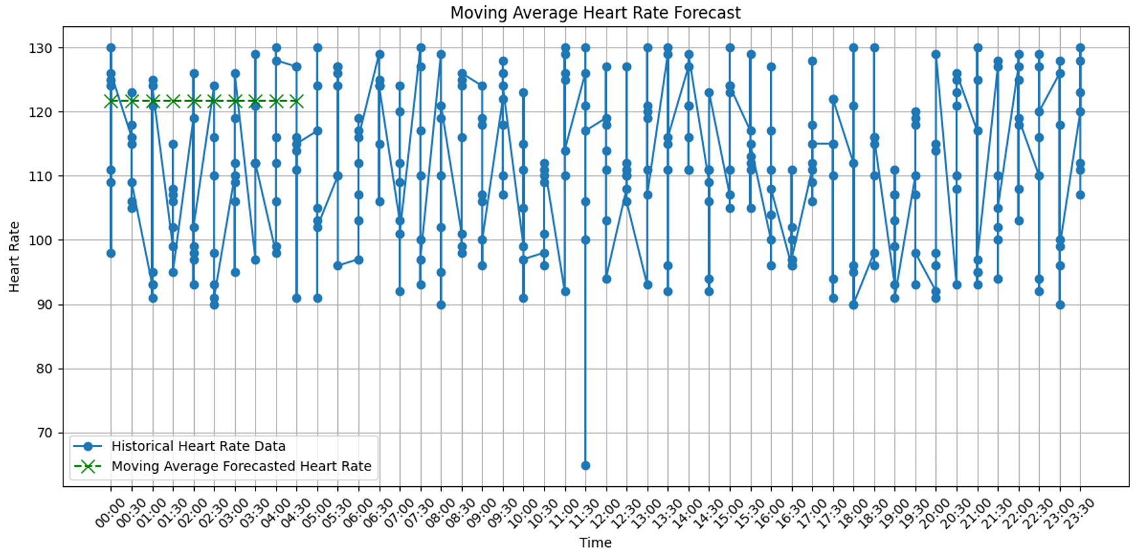
Moving average plots

Slide 21
Isolation Forests:
Unsupervised learning: not requiring labeled data
Efficiency: low computational complexity suitable for real-time anomaly detection
We also calculated the accuracy of the algorithm
One-Class SVMs:
Handling high-dimensional data: capturing complex patterns

Slide 22
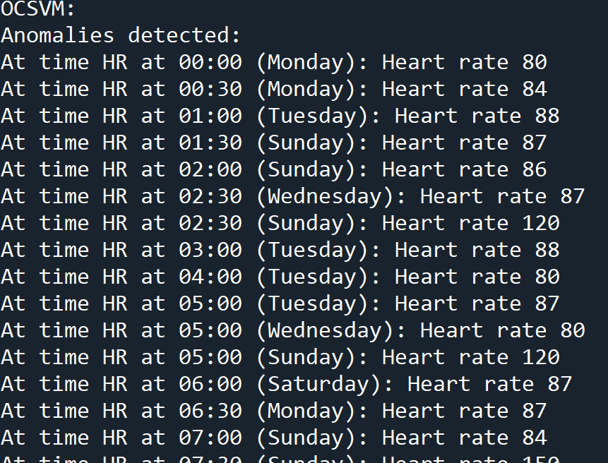
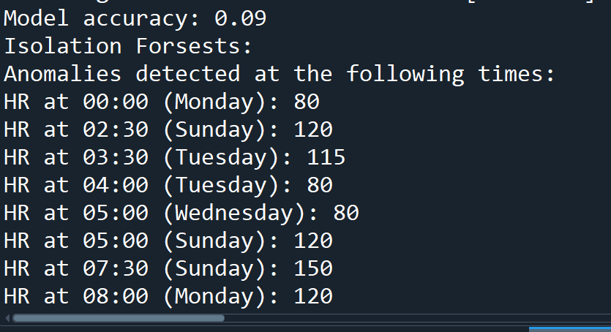

Slide 23
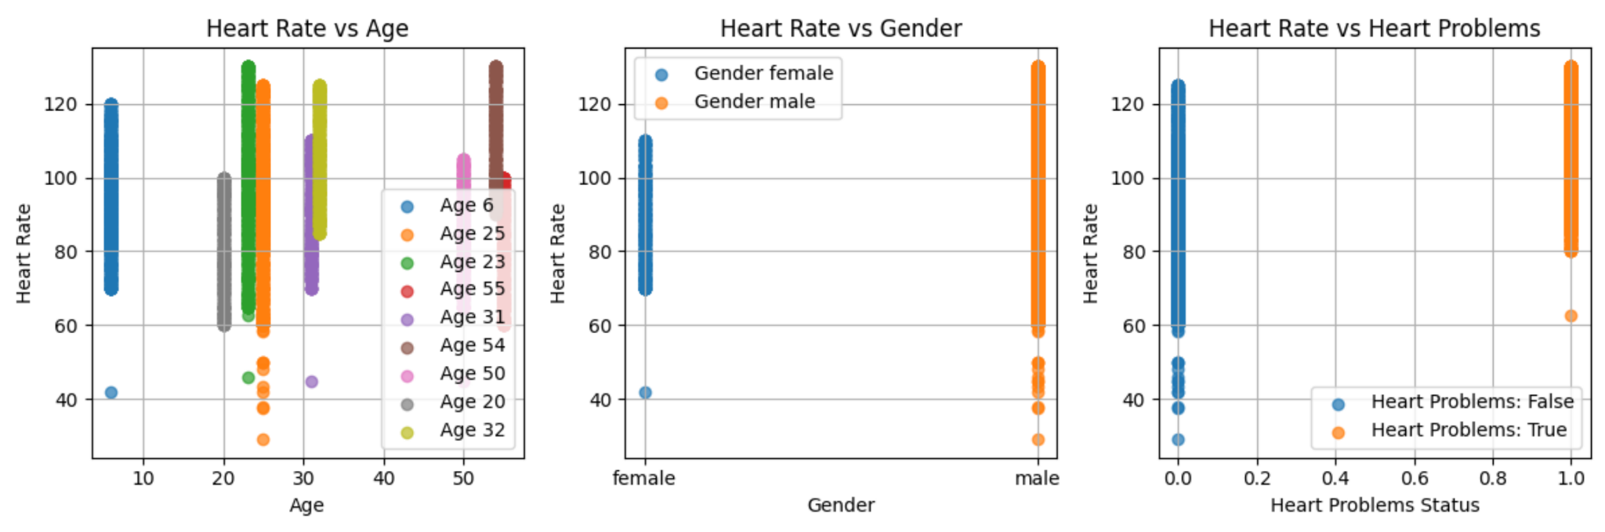
You can also see data analysis for all the users

Slide 24
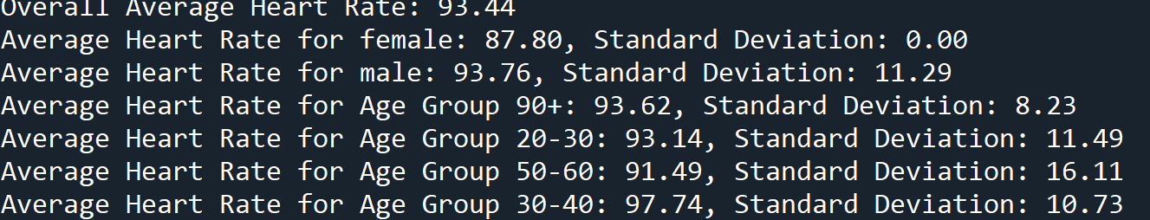

Slide 25
Testing the application
Unit Testing
Integration Testing
End-to-End Testing
Performance Testing

Slide 26
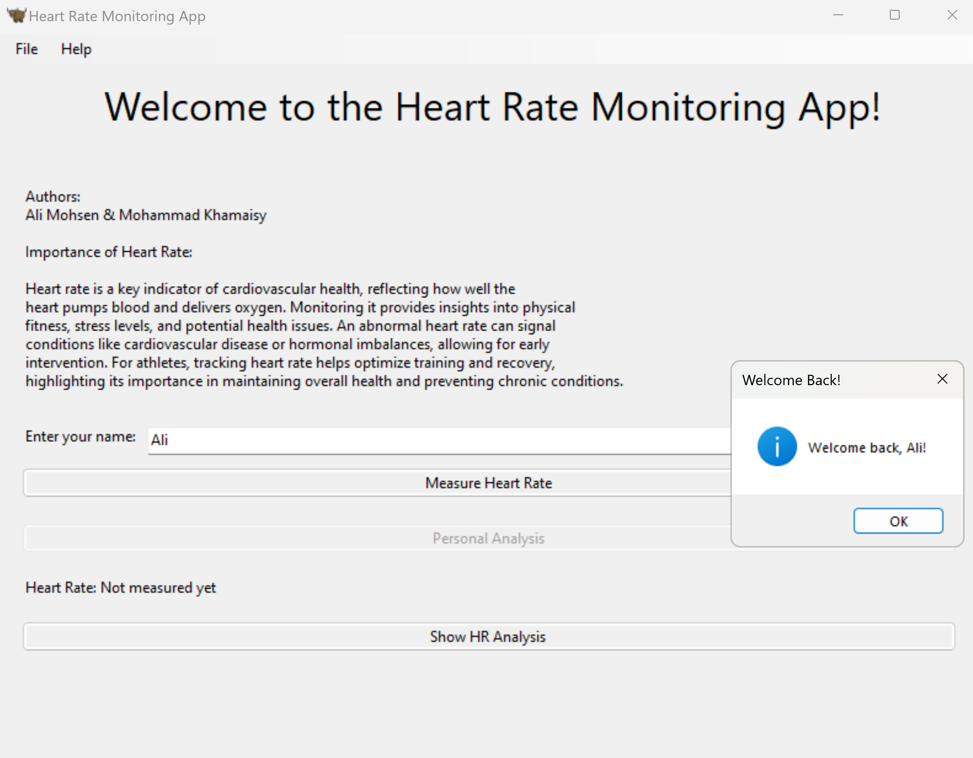
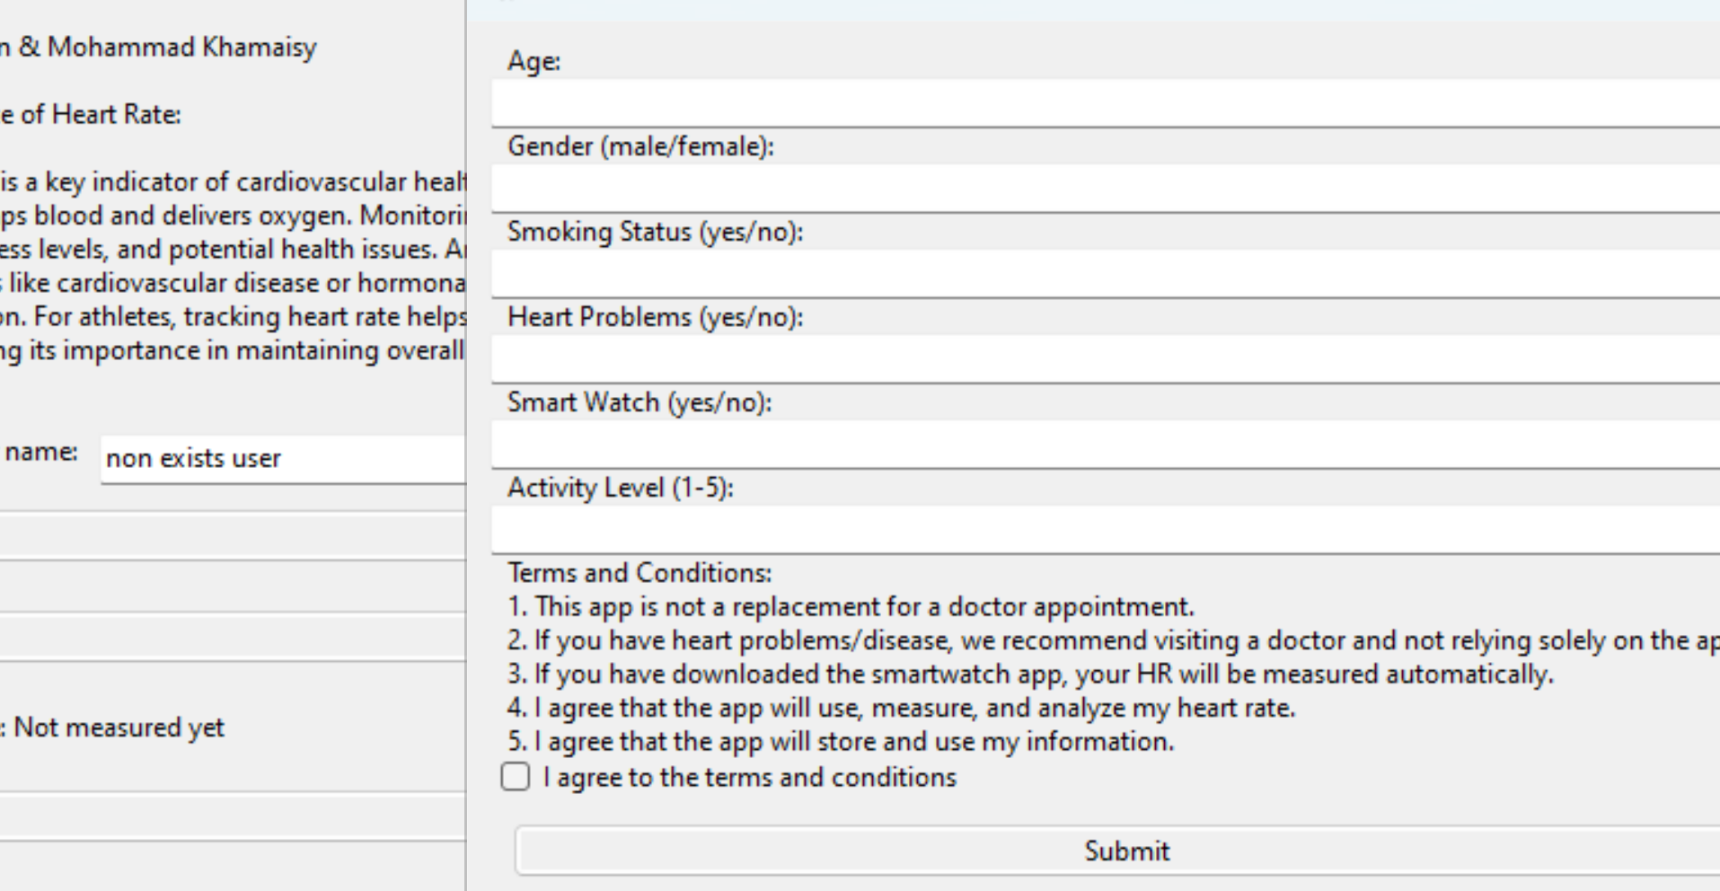

Slide 27
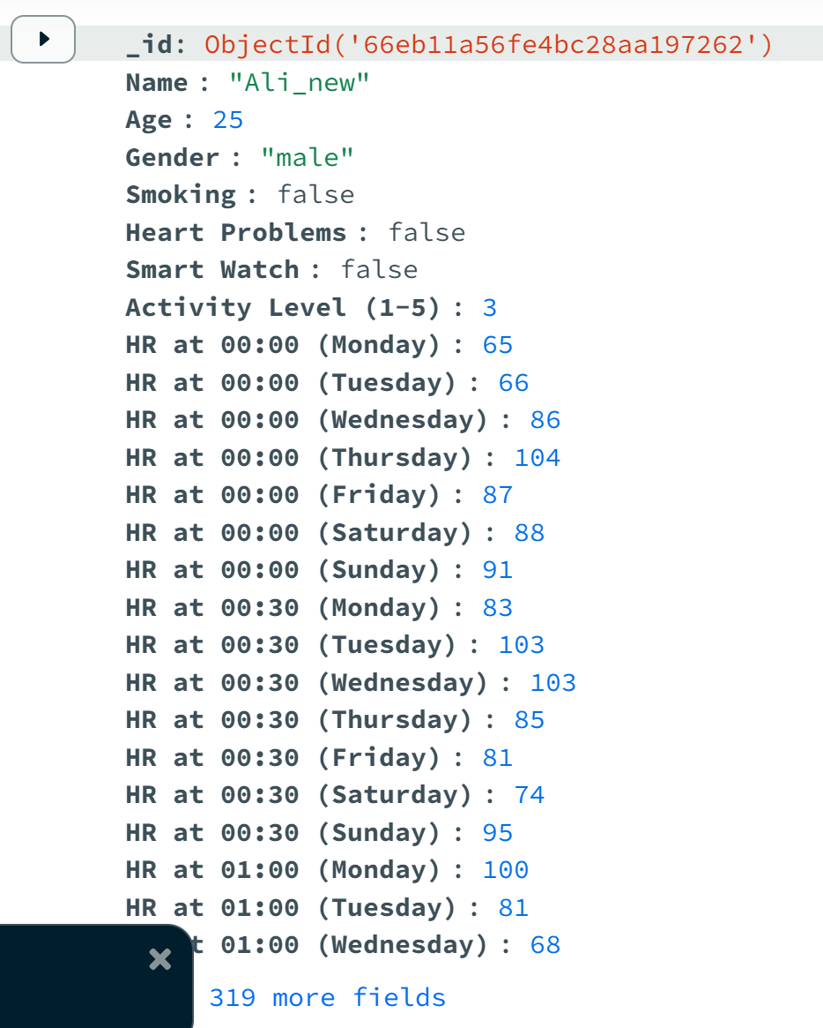
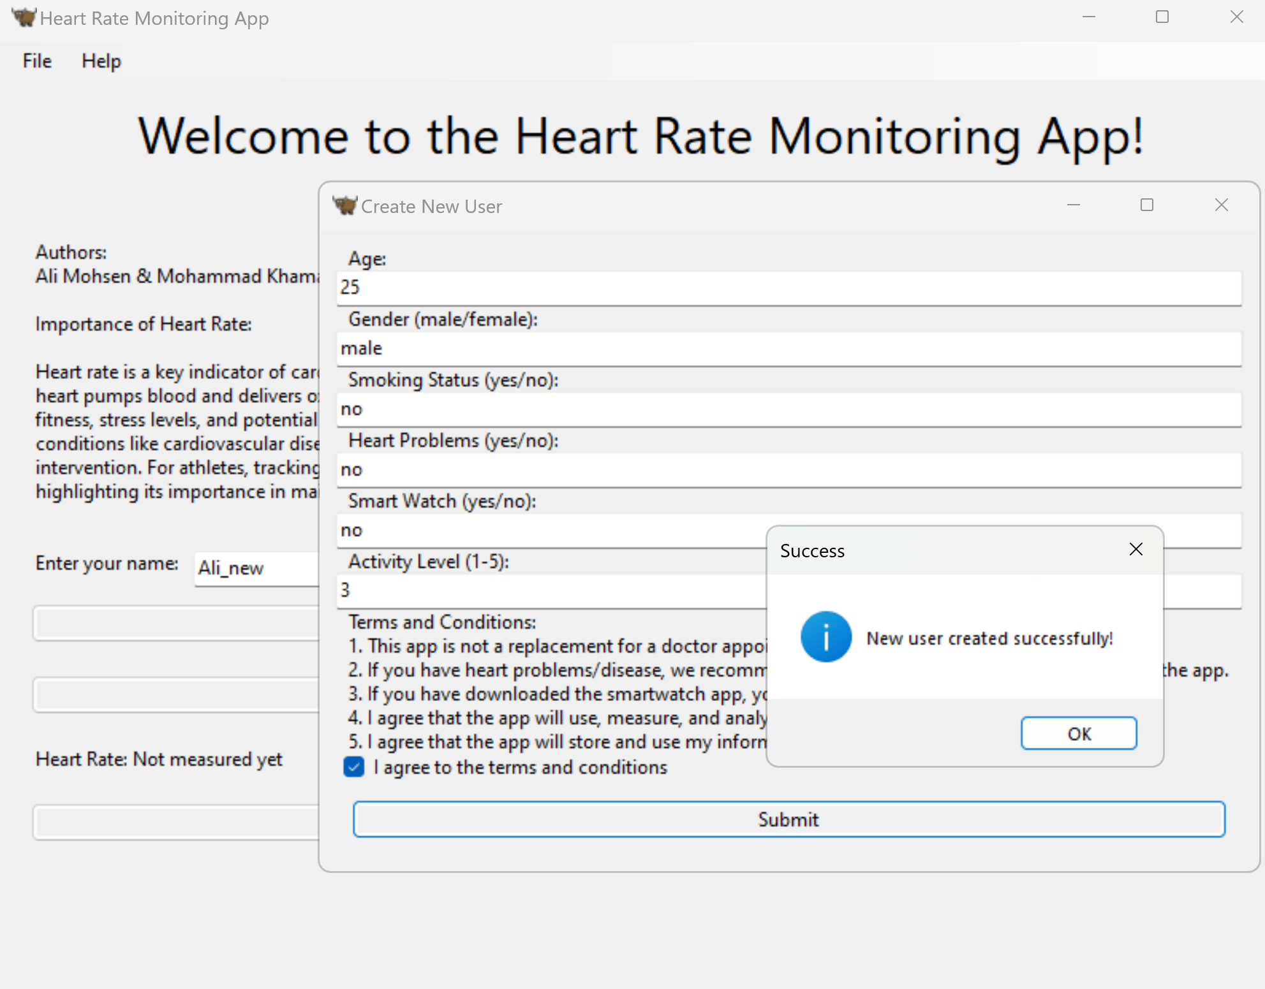

Slide 28
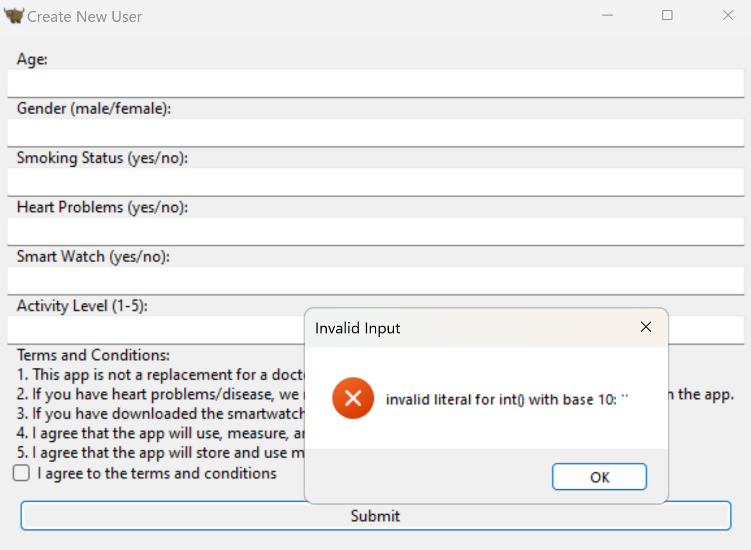
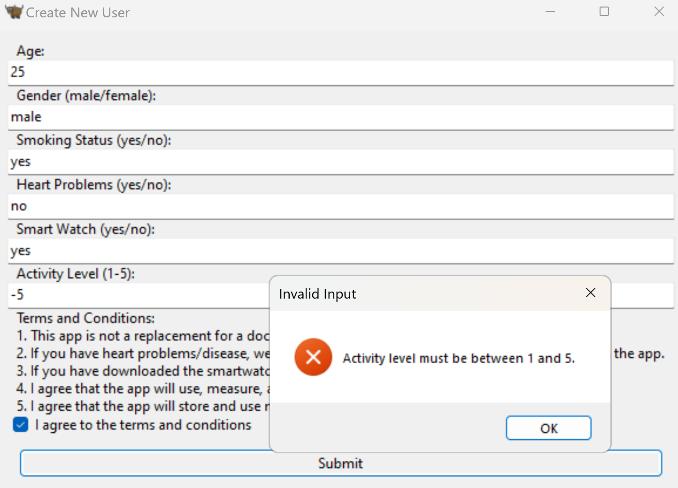
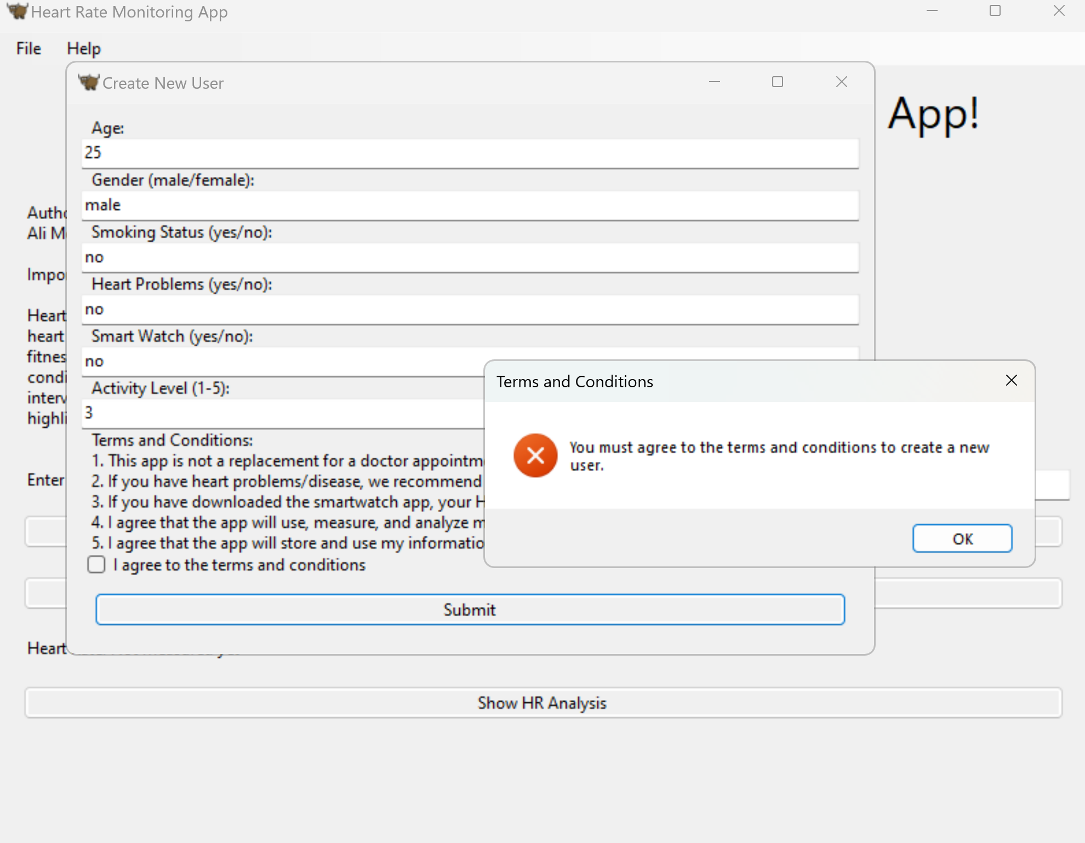
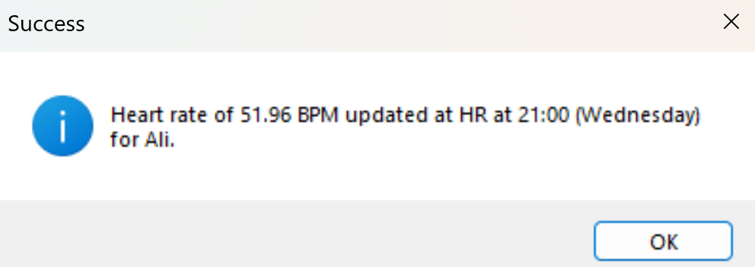
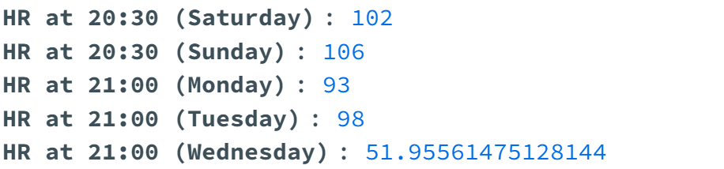

Slide 29
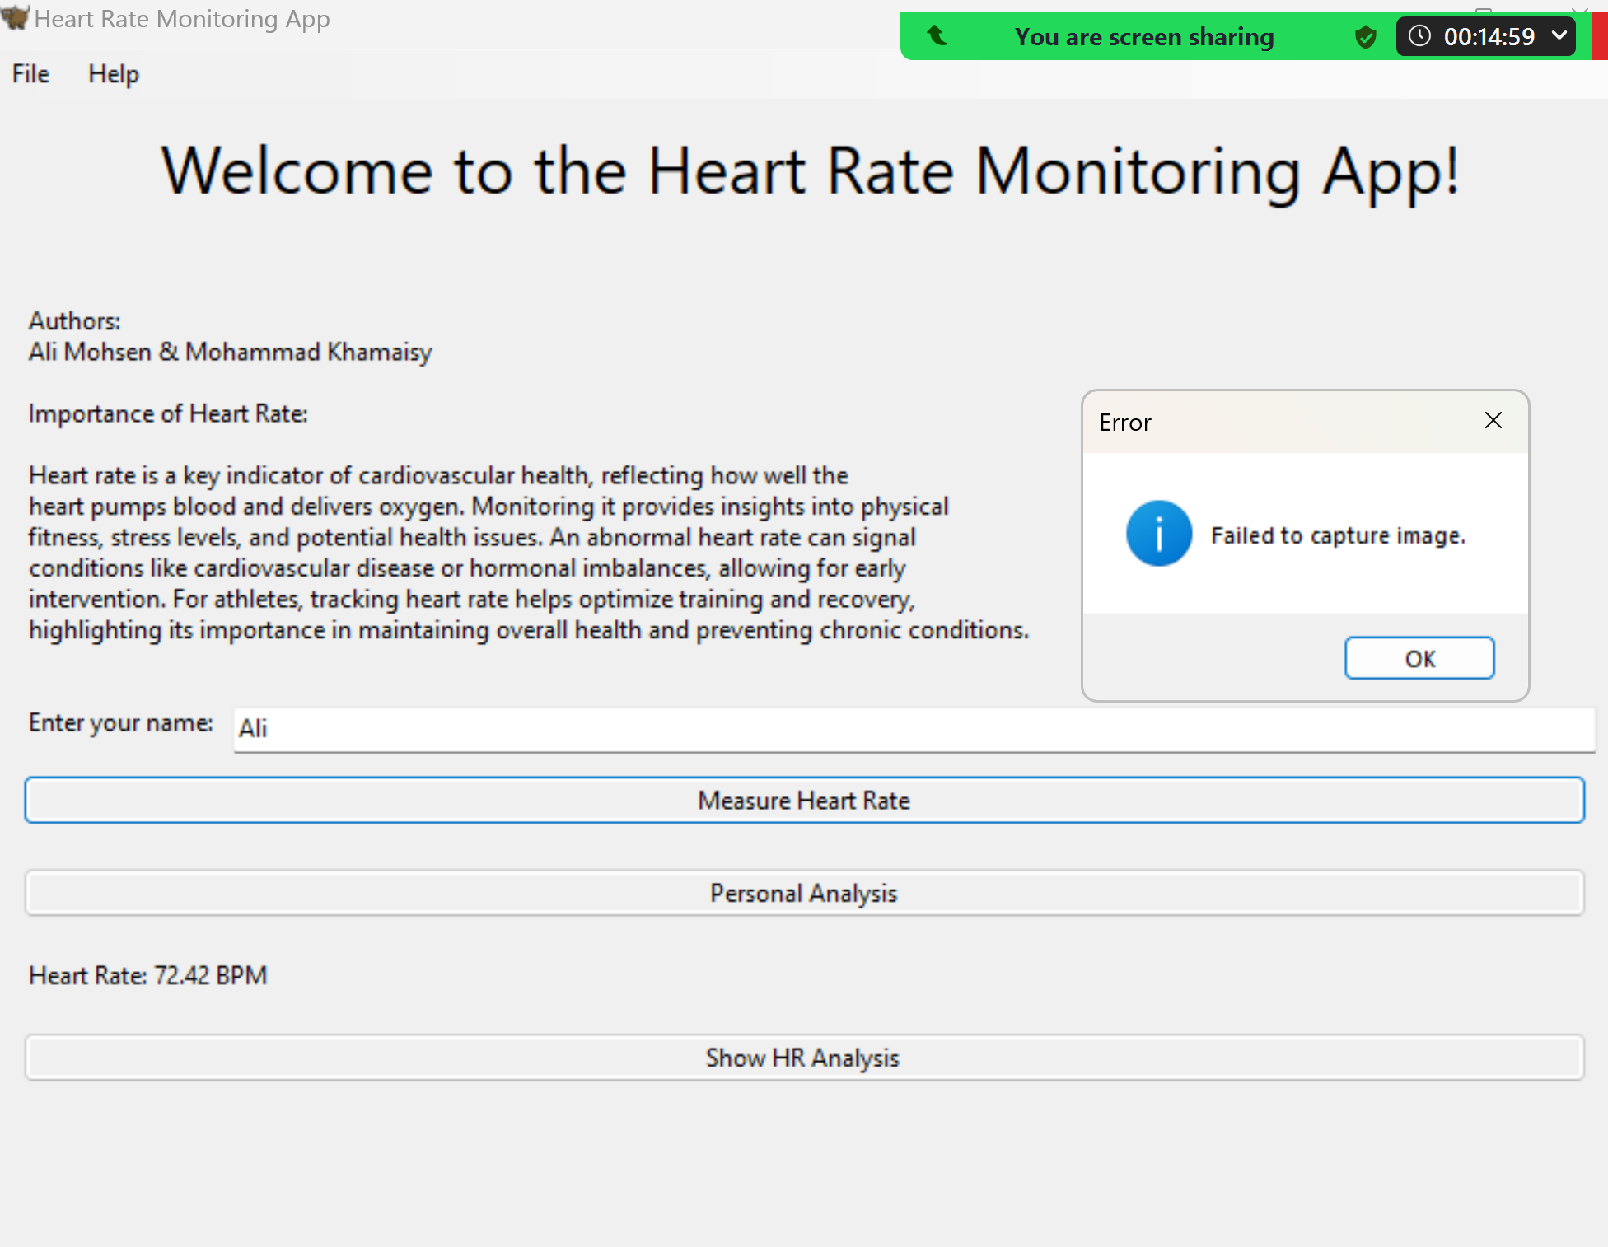
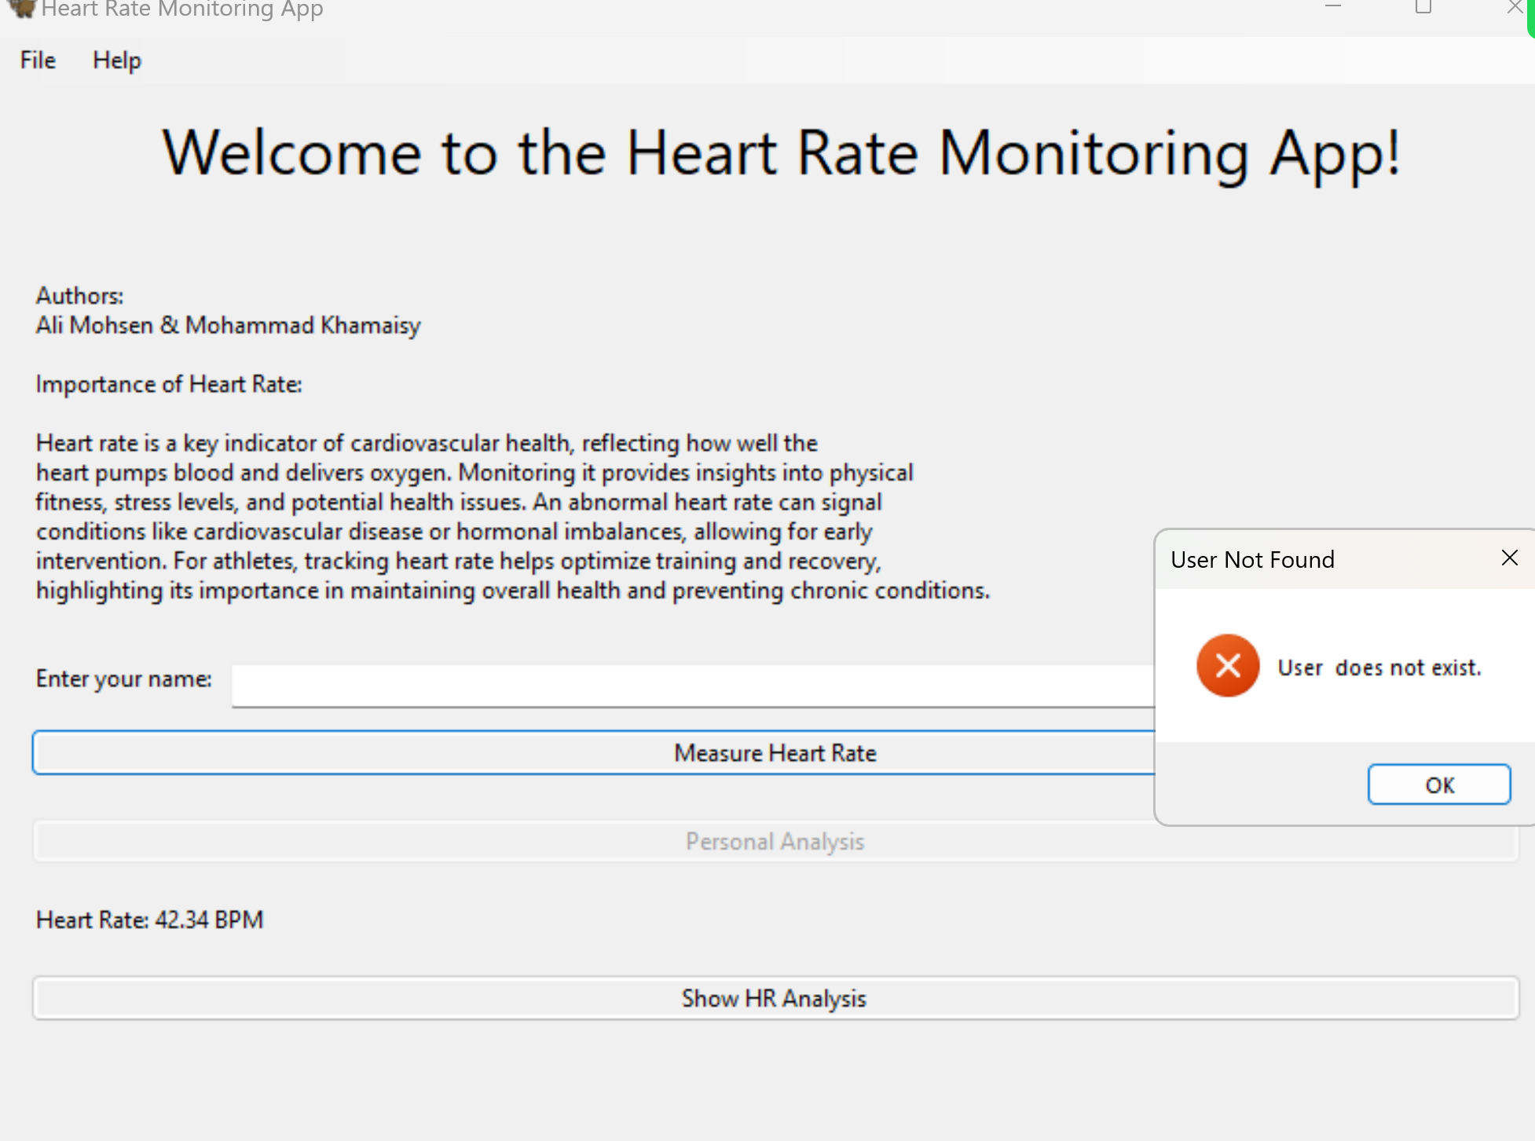
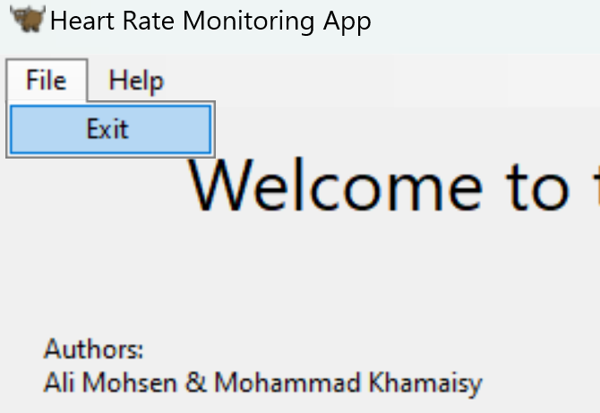

Slide 30
Conclusion
We transitioned from Java/Kotlin to Python with BeeWare's Toga platform app development, leveraging Python’s machine learning libraries to streamline development.
Building app to measure heart rate and perform personal analysis and give advices is a complex task and there are many faces to problem and many ways to solve.
Python has many built in ML algorithms
Heart rate can vary between different people according to age, gender..

Slide 31


Slide 32
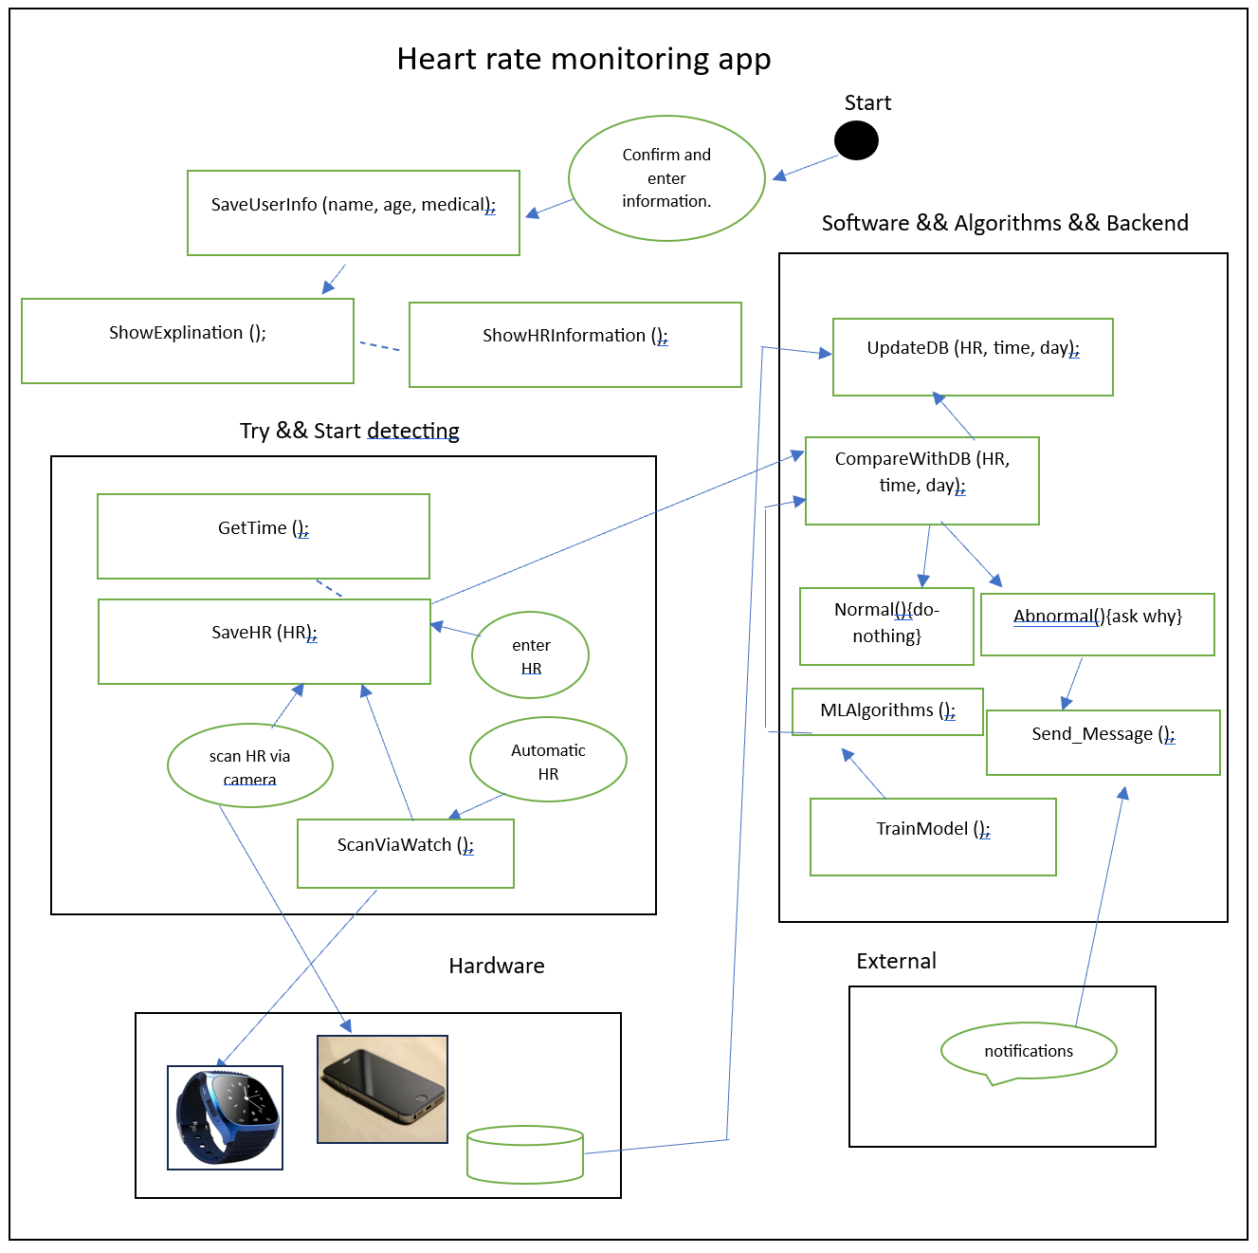
Architecture

Slide 33
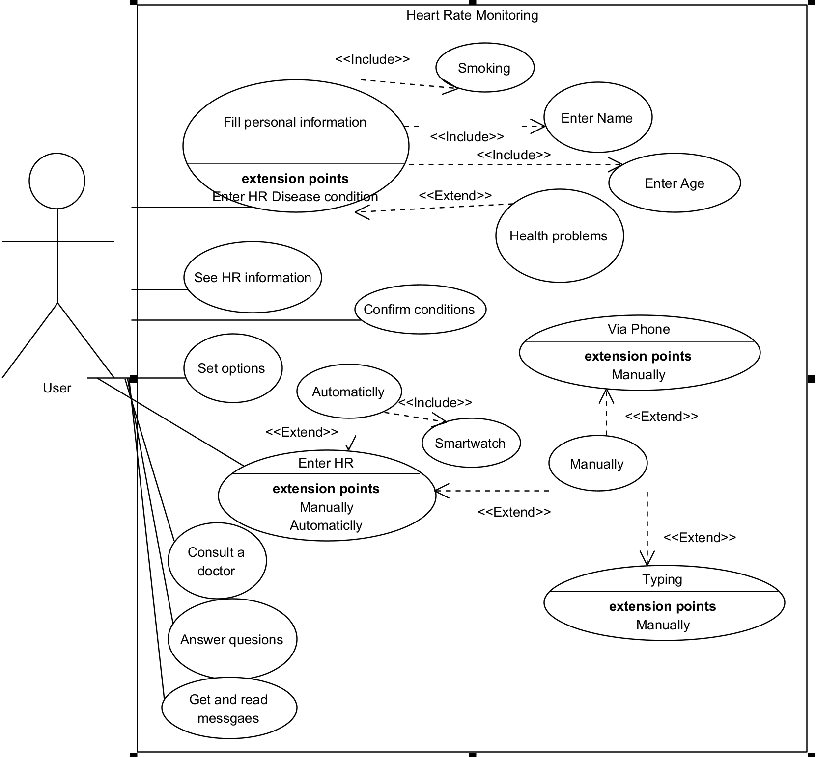
Use case:

Slide 34
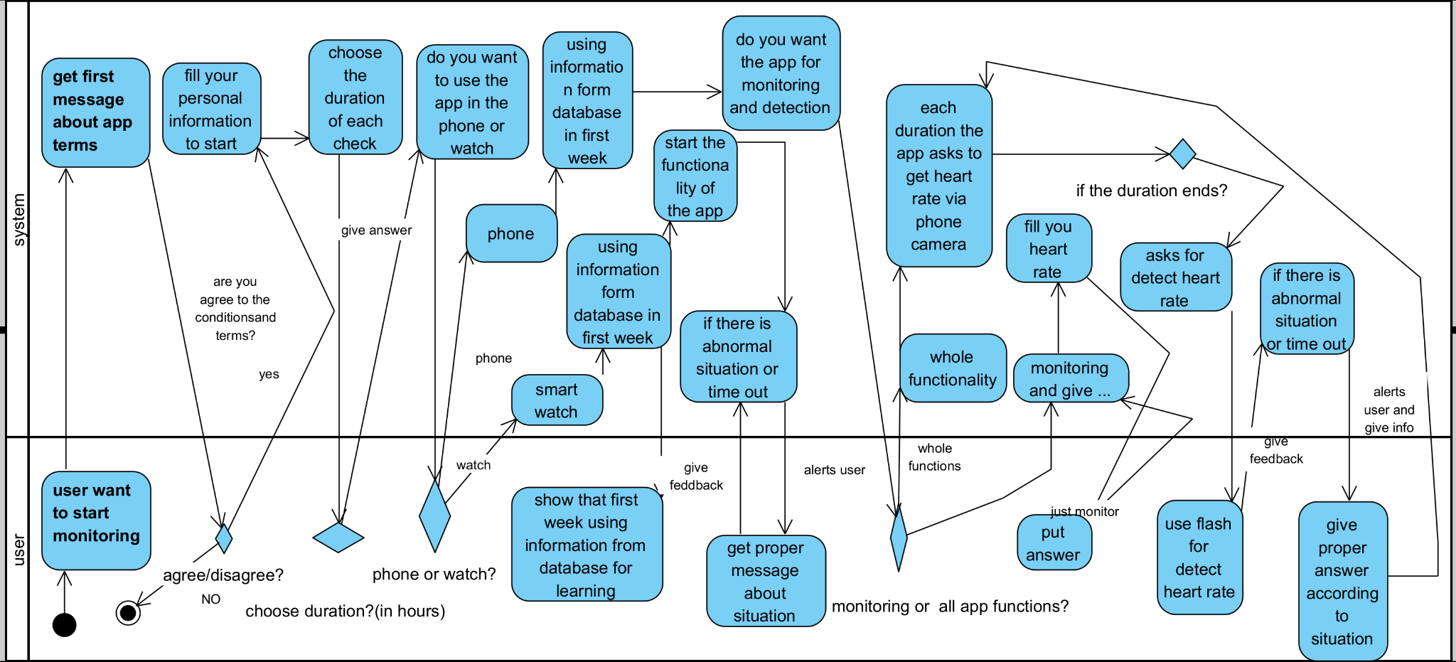
Activity Diagram

